Slide 1
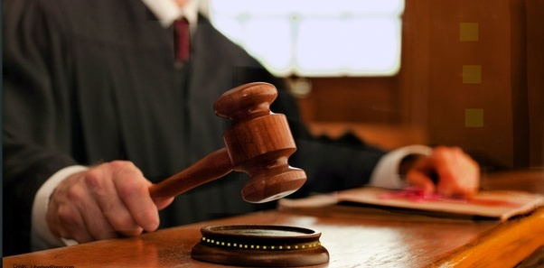
THE COURTS

Slide 2
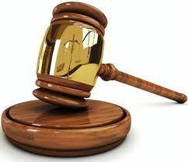
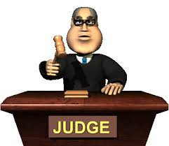
The purpose of a court
Our courts provide a forum to resolve disputes and to test and enforce laws in a fair and rational manner
Notes:
i

Slide 3
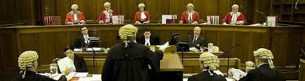
Levels of Courts
(Low to high)
Magistrates Court
District Court
Supreme Court
High Court

Slide 4
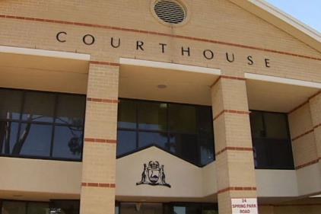
Magistrates Court
The Magistrates Court of Western Australia is the lowest court in WA.
It hears cases that are minor criminal cases such as stealing and traffic offences

Slide 5
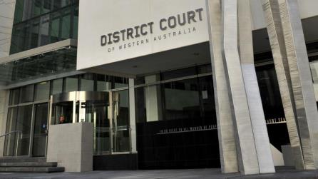
District Court
The district court is between Magistrate Court and the Supreme Court in WA.
It deals with serious criminal offence including assaults and burglary

Slide 6
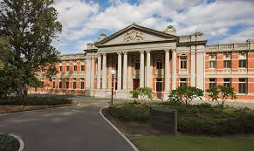
Supreme Court
The Supreme Court is the highest court in the state
It deals with serious criminal charges eg. Murder, armed robbery, drug offences
The court of Appeal hears appeals from single judge of Supreme Court and lower Court.

Slide 7
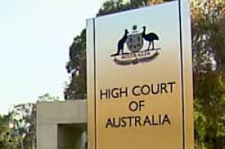
High Court
The High Court is in Canberra
The High Court is the highest court of all in Australia, they make the final decisions.

Slide 8
Court Personnel
Judge: the person who runs the courtroom and makes decisions about the law. They also make sure that lawyers follow the rules and the court is in order.
Jury: is a group of 12 people who listen to the evidence of a case. They then decide who is guilty or not guilty
Defence lawyer: is a criminal defense lawyer who specialises in defending people
Prosecution lawyer: is a lawyer from the government who brings a case against the accused person
The Accused/defendant: is the person who is on trial. They have been accused of a crime.
Witness is someone that gives evidence during the trial.

Slide 9
Court personnel 2
Judges associate/assistant: assists the judge with the case, provides information and support to the judge.
The court orderly: assists the judge and other people in the court room
Public: members of the public sit in the public gallery at the back of the courtroom
Magistrate: a judge in the magistrates court.

